Slide 1
Prioritization and Implementation Methodology
Dinuka Perera

Slide 2
Agenda
Prioritization of projects
Implementation methodology

Slide 5
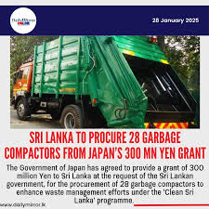

Slide 11
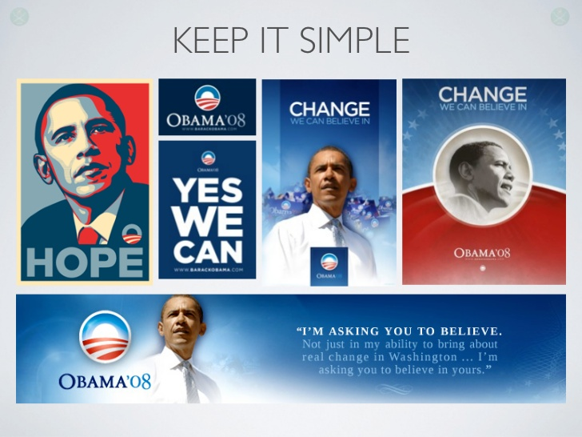

Slide 14
A project…
Seeks to create a new situation in your organization from the current one
Greater the difference between current and new situations;
Greater the degree of change
Greater the degree of resistance
Greater the likelihood of failure
Therefore, look at projects which have a manageable degree of change

Slide 15
Using a ‘Decision Framework’ to decide on a project
Impact
Visibility
Value
Usage
Urgency
Alignment
Feasibility
Availability of Technology
Ease of Implementation
Cost
User Acceptance
Synergy
Aligning with Infrastructure
Aligning with Standards
Aligning with Localization

Slide 16
Decision Framework -> Impact -> Visibility
Frequency of use (i.e. daily, weekly, monthly etc)
No. of people who use the services of the system
Segment of the population

Slide 17
Decision Framework -> Impact -> Value
Value to your organization (ie reduce overtime, increase transparency etc.)
Value to citizen (ie less waiting time)
Value to government finance (ie Cost Savings to Investment + Total Cost Avoidance by Investment)
Social Value (ie more efficient use of taxpayer money)

Slide 18
Decision Framework -> Impact -> Usage
No. of transactions

Slide 19
Decision Framework -> Impact -> Urgency
Critical needs expressed

Slide 20
Decision Framework -> Impact -> Alignment
Policies of government

Slide 21
Decision Framework -> Feasibility -> Availability of Technology
Proven Technology
Local Support

Slide 22
Decision Framework -> Feasibility -> Ease of Implementation
People
Process
Technology
Policies of the organization
Leadership
Time Frame

Slide 23
Decision Framework -> Feasibility -> Cost
Business Models
Public ~ Private Partnerships (PPP)
Build, Operate, Transfer (BOT) Ex: LGN
Build, Own, Operate, Transfer (BOOT)
Build, Own, Operate (BOO) Ex: GIC
Buy, Build, Operate (BBO)

Slide 24
Decision Framework -> Feasibility -> User Acceptance
Any foreseeable resistance
Extent of ICT usage
ICT, Internet Awareness

Slide 25
Decision Framework -> Feasibility -> Organizational Readiness
ICT Infrastructure and ICT Usage
Openness for Administrative Reforms
ICT Professional Staff
Leadership initiative and support
Senior management support
Availability of funding

Slide 26
Decision Framework -> Synergy-> Aligning with Infrastructure
Leveraging on existing systems (ie LGN)

Slide 27
Decision Framework -> Synergy-> Aligning with Standards
Adoption Standards (ie. LIFe, SOA)

Slide 28
Decision Framework -> Synergy-> Aligning with Localization
Aligning with Sinhala Unicode
Aligning with Tamil Unicode

Slide 29
Example – Project to streamline the stamp duty collection
Category | Sub Categories | Percentage | Score (out of 10) | % Total
Impact | Visibility | 15% | 7 | 1.05
 | Value | 30% | 7 | 2.10
 | Usage | 20% | 8 | 1.60
 | Urgency | 25% | 8 | 2.00
 | Alignment | 10% | 8 | 0.80
 |  | Total: |  | 7.55
Category | Sub Categories | Percentage | Score (out of 10) | % Total
Feasibility | Technology | 15% | 7 | 1.05
 | Implementation | 20% | 5 | 1.00
 | Cost | 25% | 7 | 1.75
 | User Acceptance | 20% | 5 | 1.00
 | Org. Readiness | 20% | 4 | 0.80
 |  | Total: |  | 5.60

Slide 30
Example – Project to streamline the stamp duty collection
Category | Sub Categories | Percentage | Score (out of 10) | % Total
Synergy | Infrastructure | 40% | 9 | 3.60
 | Standards | 40% | 8 | 3.20
 | Localization | 20% | 9 | 1.80
 |  |  | Total: | 8.60
Category | Weightage | Total | Weighted Total
Impact | 35% | 7.55 | 2.64
Feasibility | 35% | 5.60 | 1.96
Synergy | 30% | 8.60 | 2.58
 |  | Grand Total: | 7.18
Rule of thumb: If the Grand Total is more than 5.0, go for the project

Slide 31
Implementation Methodology

Slide 32
Project
A temporary endeavor undertaken to create a unique product, service or result
Projects should be differentiated from ‘Operational Work’
Operations are ongoing and repetitive, while projects are temporary and unique

Slide 33
Implementation methodology
How do we face challenges in implementing projects within the government?

Slide 34
Project Implementation in Government
In some instances, project delivery may not be the same in Government compared to private sector
You may not have a dedicated project manager or a project team
It is likely that you would have a project champion
You may be the ‘live wire’ between the vendors and the government

Slide 35
Challenges - Internal
Managing the expectations of the internal users
Maintaining the interest and commitment of internal staff towards the project
Balancing the requirements of the system
Signing off internal deliverables on time
Procurement activities

Slide 36
Challenges - External
Managing the external stakeholders (ie vendors, other interested groups)
Ensuring the quality of deliverables
Ensuring the timelines are adhered by
Ensuring goodwill between external and internal stakeholders

Slide 38
Methodology
Select a project using the Decision Framework
Form a Project Governance Team
Appoint a Project Champion (official responsible for leadership)
Identify a core Project Team (even if not dedicated full-time)
Define roles and responsibilities
Develop a Project Schedule
Set milestones, deliverables, and timelines.
Develop a RACI (Responsible, Accountable, Consulted, Informed)
Project Execution and Implementation
Maintain clear communications between all stakeholders
Monitor and track deliverables
Testing and User Acceptance – could be challenging
Officially launch the project
Celebrate the success!

Slide 39
Skills / Traits
Good communication skills
Good interpersonal skills
Good negotiation skills
Self confidence
Perseverance
Commitment
Integrity
Courage
“No matter what comes your way, never give up until you deliver your project successfully”

Slide 40
You
get
to
decide
the
legacy
that
you
leave
behind

Slide 41
Thank you…
Dinuka Perera Deputy Chief Executive Officer (DCEO)
LankaPay Pvt Ltd.

